Slide 1
NOAH
STAND UP, LIKE

Slide 2
March’s Keynote:
Reverence

Slide 3
Stand Up Like Noah:
Why Noah?
What Is Reverence, and How Did It Influence Noah?
How Did Noah Stand Up for Jesus?
Notes:
The reason for Noah as a topic is because of his place in Hebrews 11:

Slide 4
Hebrews 10:35-39
For you have need of endurance, so that when you have done the will of God, you may receive what was promised. For yet in a very little while, He who is coming will come, and will not delay. But My righteous one shall live by faith; And if he shrinks back, My soul has no pleasure in him. But we are not of those who shrink back to destruction, but of those who have faith to the preserving of the soul.

Slide 5
Hebrews 11:7
By faith Noah, being warned by God about things not yet seen, in reverence prepared an ark for the salvation of his household, by which he condemned the world, and became an heir of the righteousness which is according to faith.

Slide 6
Why Noah?
Warned about things not yet seen
In reverence, prepared an ark
For the salvation of his household
By which he condemned the world
And became an heir of the righteousness which is according to faith
Notes:
(Genesis 2:5-6)
(Genesis 6:13-22; 7:1-5)
(Gen. 7:7; 8:15-18)
(Gen. 7:20-23; 1 Peter 3:18-20)
(Genesis 8:20-9:17)

Slide 7
What Is Reverence?
Notes:
He was the first (known) prophet – he accurately conveyed God’s word, but is this WHY He was pleasing to God? I don’t think so…

Slide 8
What is Reverence?
“You shall fear the LORD your God; you shall serve Him and cling to Him, and you shall swear by His name. He is your praise and He is your God, who has done these great and awesome things for you which your eyes have seen.”
- Deuteronomy 10:20-21
Notes:
Concept > Word > Concept

Slide 9
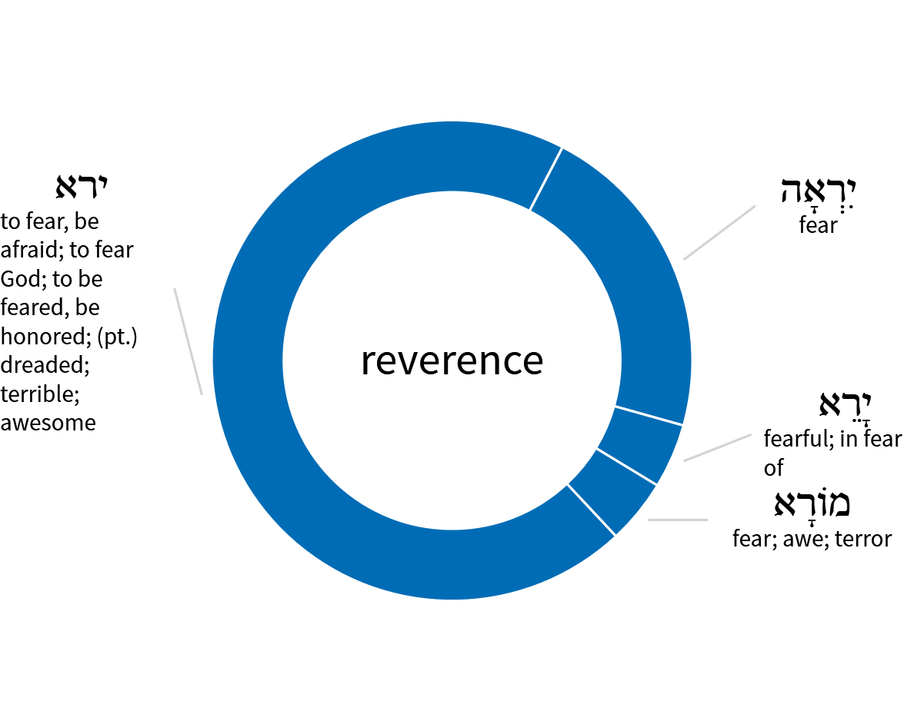
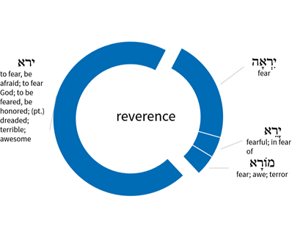

Slide 10
What Is Reverence?
To fear, revere, be afraid…To stand in awe of, be awed. To fear, reverence, honor, respect.
-Enhanced Strong’s Lexicon; #H3372

Slide 11
What is Reverence?
“You shall fear the LORD your God; you shall serve Him and cling to Him, and you shall swear by His name. He is your praise and He is your God, who has done these great and awesome things for you which your eyes have seen.”
- Deuteronomy 10:20-21

Slide 12
How Did Reverence Influence Noah?
Thus Noah did;
according to all that God had commanded him,
so he did.

Slide 13
How Did Noah Stand Up for Jesus?
He Was Righteous and Blameless
He Obeyed God
He Walked with God
He Condemned the World

Slide 14
“You shall fear the LORD your God; you shall serve Him and cling to Him, and you shall swear by His name. He is your praise and He is your God, who has done these great and awesome things for you which your eyes have seen.”
- Deuteronomy 10:20-21

Slide 15
But even if you should suffer for the sake of righteousness, you are blessed. And do not fear their intimidation, and do not be troubled, but sanctify Christ as Lord in your hearts, always being ready to make a defense to everyone who asks you to give an account for the hope that is in you, yet with gentleness and reverence; and keep a good conscience so that in the thing in which you are slandered, those who revile your good behavior in Christ will be put to shame.
- 1 Peter 3:14–16

