Slide 1
Harmonizing the Resurrection
April 18th, 2014

Slide 2
Reading the four accounts
Matthew 28:1-17
Mark 16:1-14
Luke 24:1-43
John 20:1-29

Slide 3
When did the women go to the tomb?
As Sunday began to dawn (Matthew 28:1).
Very early in the morning, when the sun had risen (Mark 16:2).
Very early in the morning (Luke 24:1).
Early on Sunday, while it was still dark (John 20:1).

Slide 4
Who went to the tomb?
Mary Magdalene and “the other Mary” (Matthew 28:1).
Mary Magdalene, Mary the mother of James and Salome (Mark 16:1).
Mary Magdalene, Joanna, Mary the mother of James, and other women (Lk. 24:9).
Mary Magdalene (John 20:1).

Slide 5
How many angels? Where were they?
An angel sat on the stone (Matt. 28:2).
The women saw a young man in white inside the tomb (Mark 16:5).
The women saw two men in the tomb (Luke 24:4).
Mary saw no angel initially (John 20:1-2); upon returning to the tomb, she spoke with two angels (vs. 12).

Slide 6
Who told the apostles?
The women told the apostles (Matt. 28:8).
The women “said nothing to anyone, for they were afraid” (Mk. 16:8).
The women rushed to tell the apostles (Luke 24:9-10).
Mary went and told Peter and John initially (John 20:2); then she told all the apostles of His resurrection (vs. 18).

Slide 7
To whom did Jesus appear and when?
He met the women as they went to tell the apostles (Matt. 28:9-10).
He first appeared to Mary Magdalene (Mark 16:0-11), then to two disciples as they walked into the country (vs. 16:12-13).
He appeared to Peter (Luke 24:34). Then He appeared to two disciples on road to Emmaus (vs. 24:13-35), then to all the disciples (vs. 36-43).
He appeared to Mary Magdalene (John 20:14-17), then to the disciples that same evening (vs. 19-23), then again eight days later (vs. 24-29).

Slide 8
Where would Jesus meet the apostles?
In Galilee (Matthew 28:7; Mark 16:7).
In Jerusalem (Luke 24:33-42).

Slide 9
A few other alleged contradictions…
It appears in Matthew that the stone wasn’t rolled away when the women arrived. The other accounts indicate it was already rolled away.
The women rejoiced (Mt. 28:8); Mary wept outside the tomb (Jn. 20:11).
Paul says that Jesus was seen by over 500 brethren at once (1 Cor. 15:6) but none of the gospels mention this. Why not?
Did Jesus ascend soon after His resurrection (Luke) or after 40 days with His apostles (Acts 1:1-3)?

Slide 10
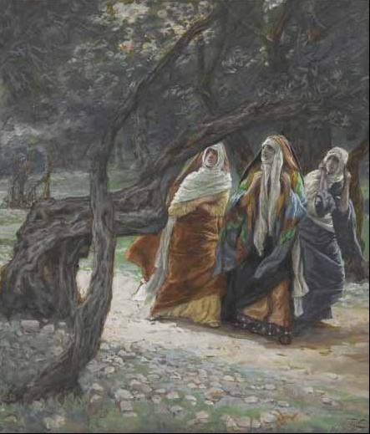
Harmonizing the Resurrection – Women Go to the Tomb
Mary Magdalene, Mary the mother of James, Salome, Joanna, other women.
They leave before dawn, while it’s dark.
They wonder how they will roll away the stone.

Slide 11
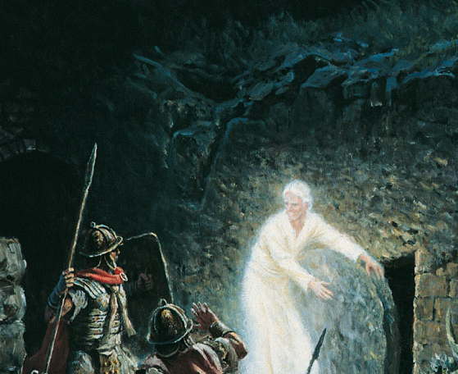
Harmonizing the Resurrection – Angel Rolls Away the Stone
There is an earthquake.
An angel appears to roll away the stone.
The guards are frozen in fear. They flee to report to the chief priests.

Slide 12
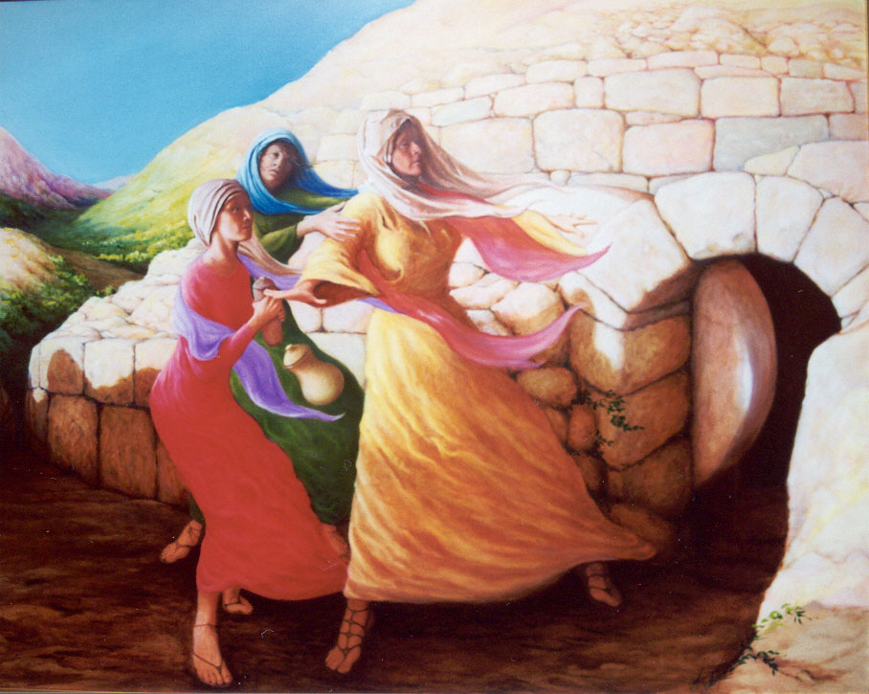
Harmonizing the Resurrection – The Women Arrive at Tomb
The sun is rising.
The women arrive to find the stone rolled away already!
Jesus’ body is missing!
They are distraught.

Slide 13
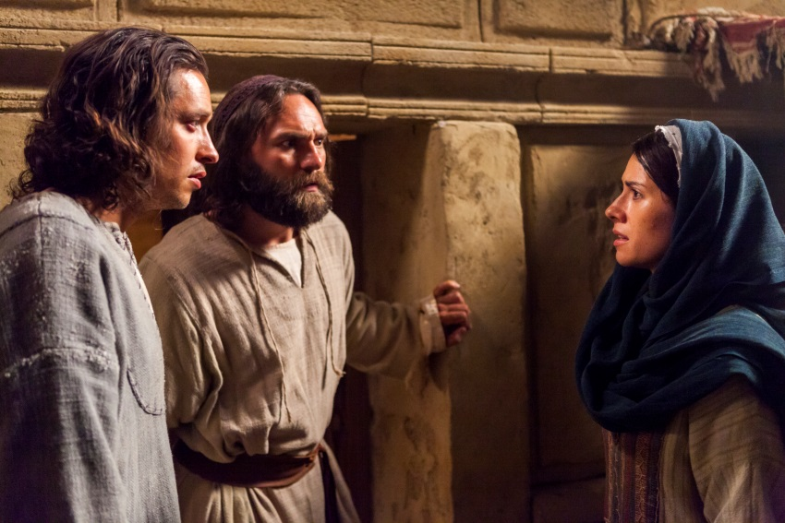
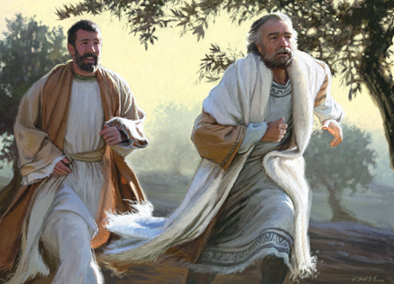
Harmonizing the Resurrection – Mary Runs to Peter & John
Mary Magdalene runs to tell Peter and John that Jesus’ body is missing.
Peter and John run to the tomb. Mary follows.
Peter and John are perplexed. The disciples return to their homes.

Slide 14
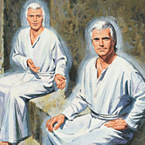
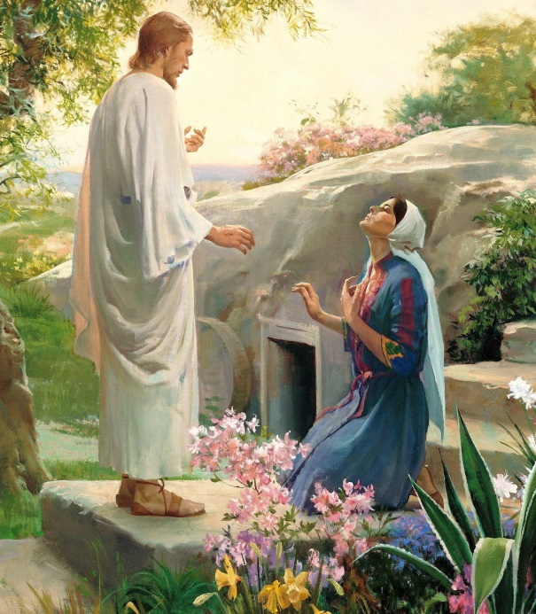
Harmonizing the Resurrection – Two Angels & Jesus
The women enter the tomb to find two angels sitting near Jesus’ grave clothes.
“Why are you weeping?”
Mary sees a “gardener” outside the tomb and goes to speak to him. It’s Jesus!
Meanwhile, the angels announce Jesus’ resurrection to the other women.

Slide 15
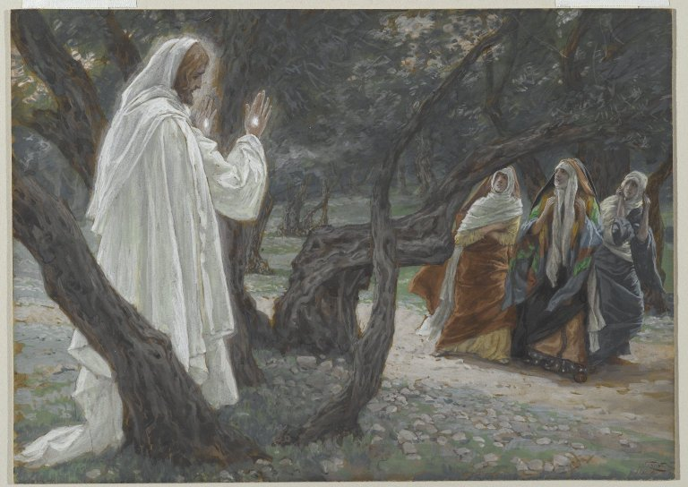
Harmonizing the Resurrection – The Women Worship Jesus
The other women exit the tomb. Together with Mary, they worship Him.
They tell no one except the apostles.

Slide 16
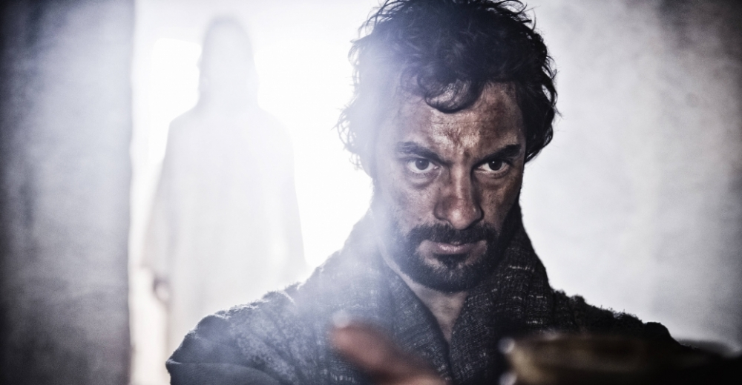
Harmonizing the Resurrection – Peter Sees Jesus
After hearing of Jesus’ resurrection, Peter and John return to the tomb.
Peter encounters Jesus here (Luke 24:34).

Slide 17
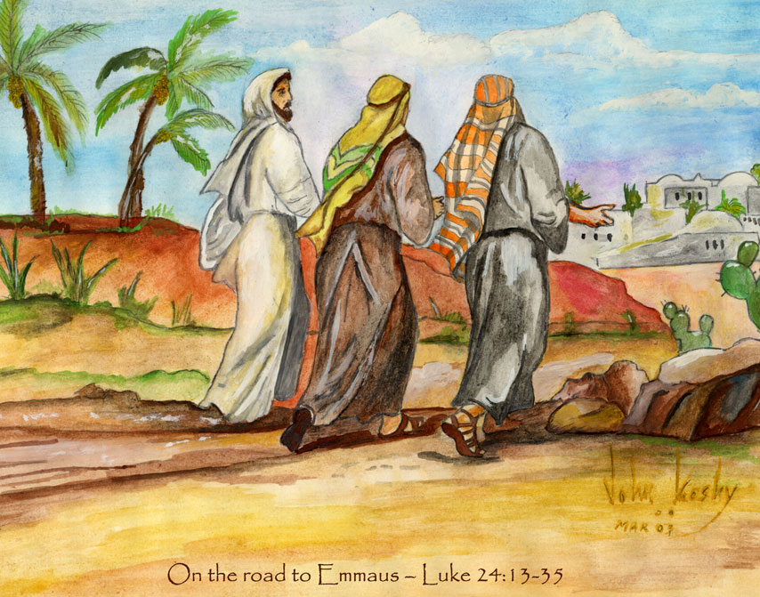
Harmonizing the Resurrection – On the Road to Emmaus
Jesus appears to the two disciples on the road to Emmaus. One is Cleopas.
He dines with them and then vanishes.

Slide 18
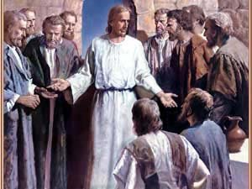
Harmonizing the Resurrection – He Appears To The Disciples
The two disciples run to tell the apostles that they have seen the risen Jesus.
Jesus appears to them all.

Slide 19
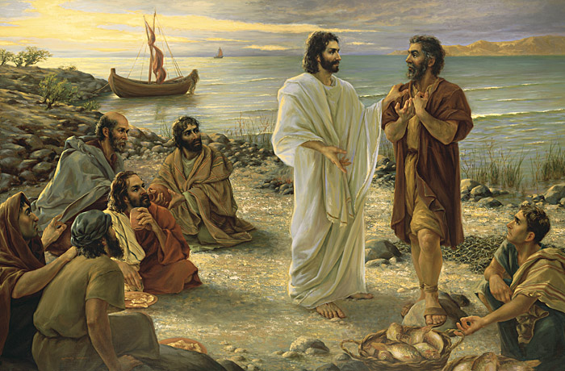
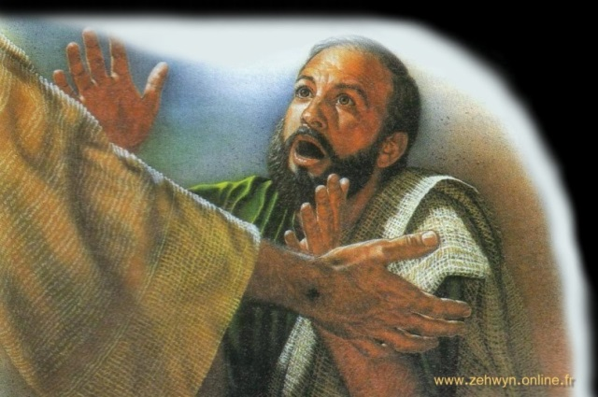
Harmonizing the Resurrection – In Galilee
He appears to 500 at once (1 Cor. 15:6).
Eight days later, Jesus appears to them a second time, probably in Galilee. Thomas believes!
He challenges Peter and teaches the disciples.

Slide 20
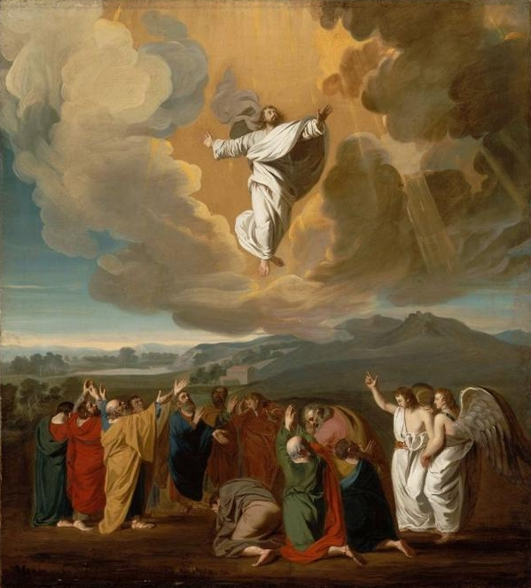
Harmonizing the Resurrection – The Ascension
Jesus and the disciples return to Jerusalem.
He has been with them for 40 days.
Jesus gives the “Great Commission.”
He ascends into heaven.

Slide 21
Conclusion
Read 1 Corinthians 15:1-19.
Without the resurrection, the entire story of Jesus falls apart.
His resurrection proves that He was the Son of God, not a mere man.
His resurrection gives us hope that we can overcome death as well!

