Slide 1
Our Base Text: Romans 1
We’re accountable to THE God (vs. 18-19).
God has revealed Himself to us (vs. 20).
Many refuse to accept God “as He is” (vs. 21-23).
Idolatry/false religion → immorality (vs. 24-31).
A religion that pleases them (vs. 32).

Slide 2
Immordolatry
Showing the Connection Between
Idolatry and Immorality

Slide 3
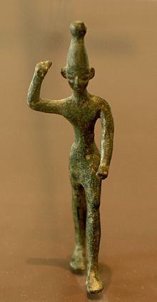
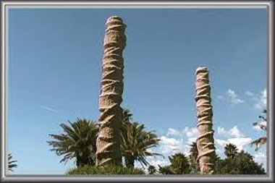
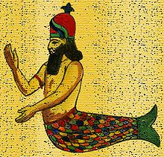
Immordolatry in the Old Testament
Baal
- 1 Kings 17-18
Judges 16:23
1 Chron. 10:10
1 Sam. 5
Asherah Pole
Dagon

Slide 4
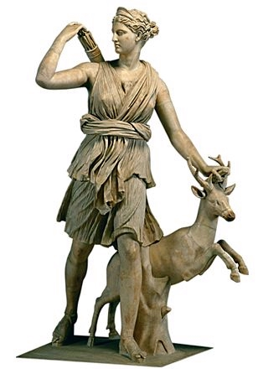
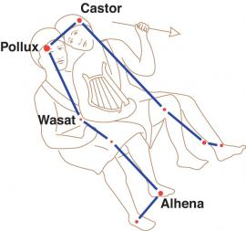
Immordolatry in the New Testament
Diana (Artemis)
Acts 19:24-35
Twin Brothers – Castor & Pollux (Gemini)
Acts 28:11

Slide 5
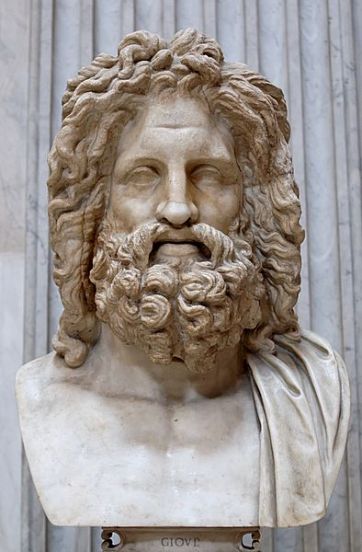
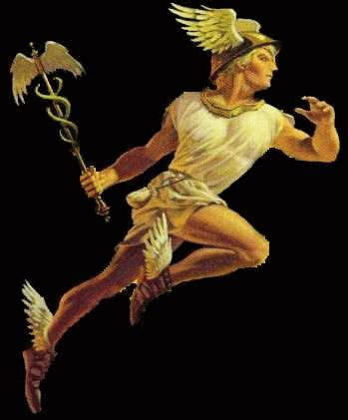
Immordolatry in the New Testament
Zeus & Hermes
“And Barnabas they called Zeus, and Paul, Hermes, because he was the chief speaker” (Acts 14:12).

Slide 6
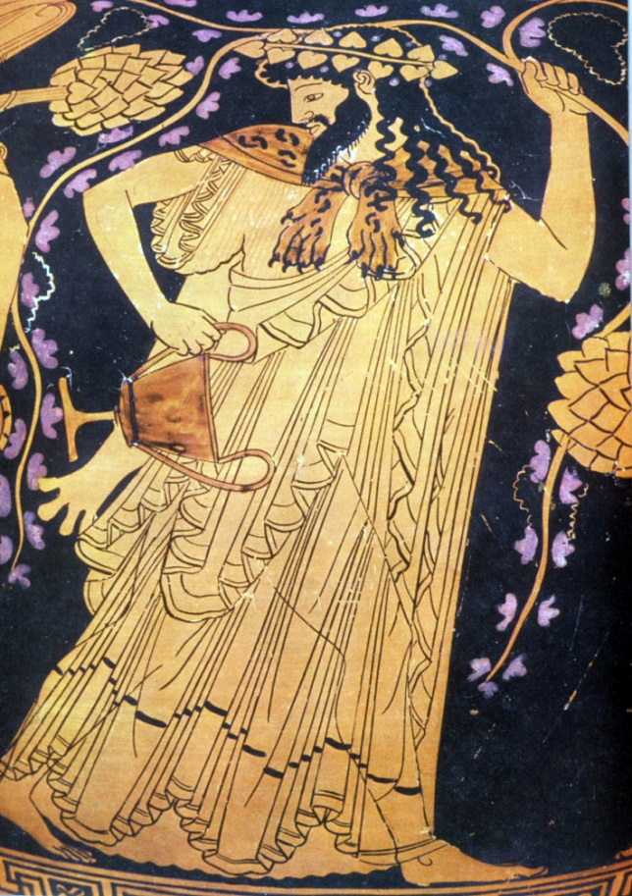
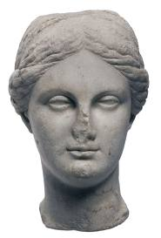
Immordolatry in the New Testament
Dionysus (Bacchus)
Aphrodite

Slide 7
The Influence of Gnosticism
Denial of a supreme, authoritative God; god is a glorified human.
Father god and mother goddess – we are literal offspring of god.
God doesn’t tell us how to act or think; instead, we use our knowledge (gnosis) and reason to seek out our own concept of god.
“The gnostic style of faith is free, open and creative.”
Identity of God changed → loose, immoral behavior.

Slide 8
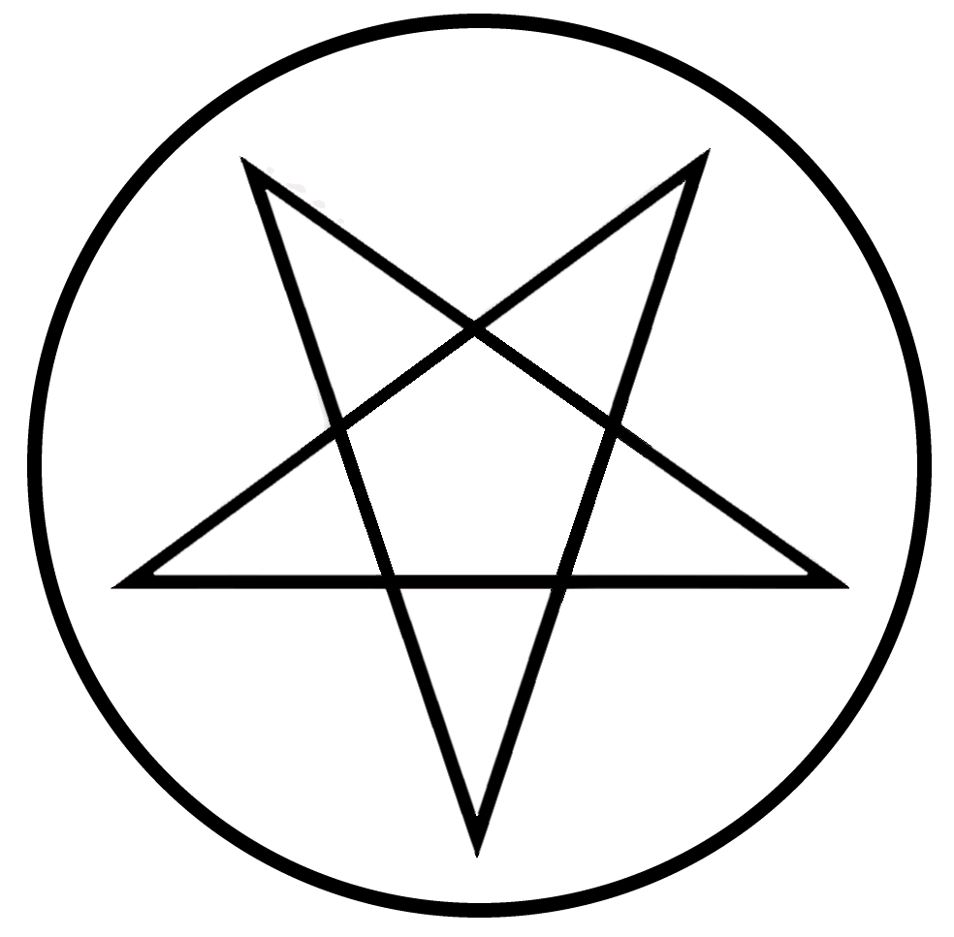
Immordolatry Today: WICCA
God and goddess – expressed in nature.
A “spiritual system that fosters the free thought and will of the individual” (from wicca.com).
Involves use of witchcraft, spells.
The symbol is the pentagram.
From 2001 – 2008, number of Wiccans doubled!
Strong influence among young people.

Slide 9
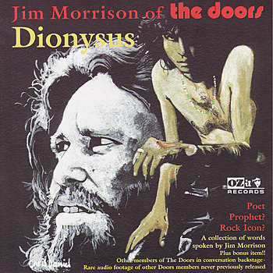
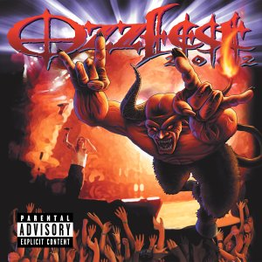
Immordolatry Today: MUSIC

Slide 10
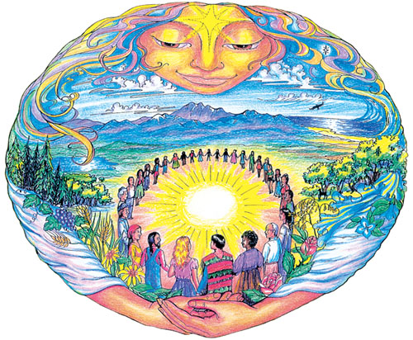
Immordolatry Today: New Age Movement
Spread through the occult and metaphysical religious communities in the 1970s and ʾ80s.
The movement’s strongest supporters were followers of modern esotericism, a religious perspective that is based on the acquisition of mystical knowledge and that has been popular in the West since the 2nd century ad, especially in the form of Gnosticism.
The New Age aims to create "a spirituality without borders or confining dogmas" that is inclusive and pluralistic.
Hippie movement, self-expression, Mother Earth.

Slide 11
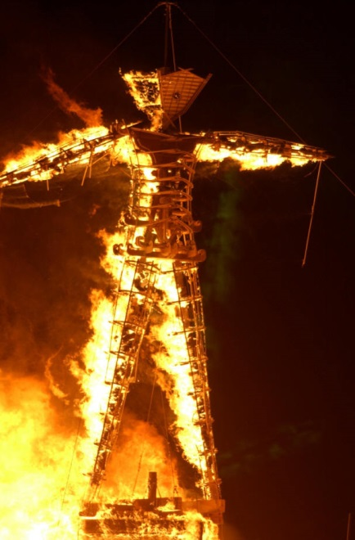
Immordolatry Today: BURNING MAN
“The temporary erasure of societal, social, and personal boundaries is, for most of us, terrifying. Such boundaries help build the structures of society and self; they give form to human life, which is often chaotic and unpredictable…But if religion creates boundaries, mysticism and spirituality efface them. In the transcendence of ordinary distinctions, peak experiences such as those encouraged at Burning Man give a glimpse of the ultimate, the infinite. It may seem absurd to suggest that Burning Man is a mystical event. But then, if it's just a big party, why is there a temple in the middle of it?”

Slide 12
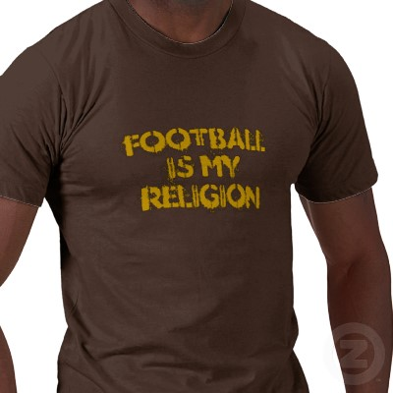
Immordolatry Today: SPORTS

Slide 13
Conclusion
These religions and/or philosophies (from Baal worship, to Greek/Roman mythology, to Wicca, to the New Age Movement) do not mandate righteous/holy living and purity; all about “self-expression” and gratifying the flesh.
Rather than allow our desires and philosophies to define God, we must allow God to define our desires and philosophies.

