Slide 1
Is Christianity Merely a Western Religion?
Merging the Bible & History

Slide 2
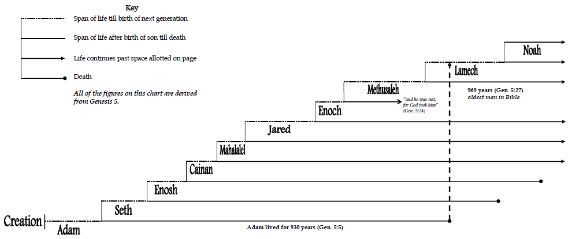
Stories From Grandpa Adam – From Creation to the Flood
130 years

Slide 3
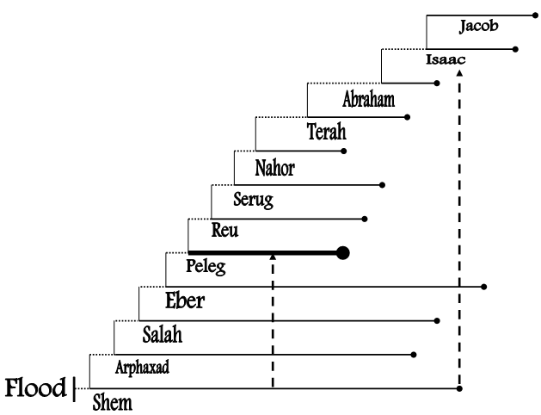
Stories From Grandpa Adam – From the Flood to Abraham

Slide 4
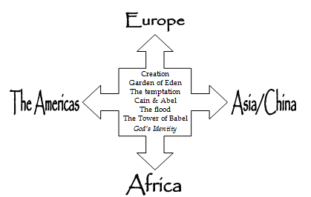

Slide 5
The Religion of Ancient China
Ancient Chinese were monotheistic.
They worshiped a supreme God named Shang-Ti.
Evidence from Chinese symbols…

Slide 6
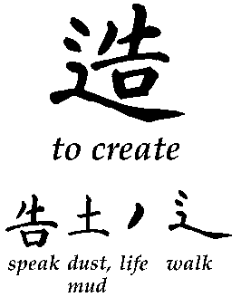
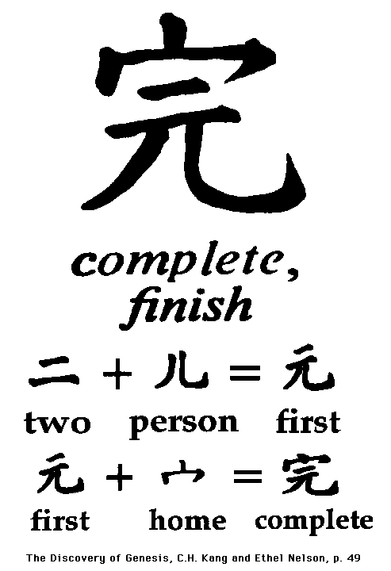
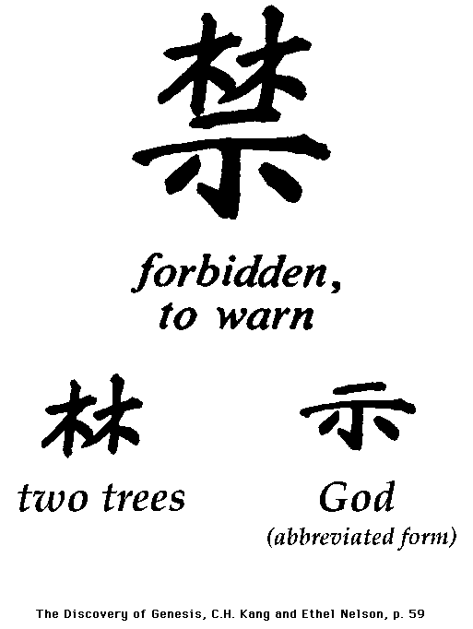
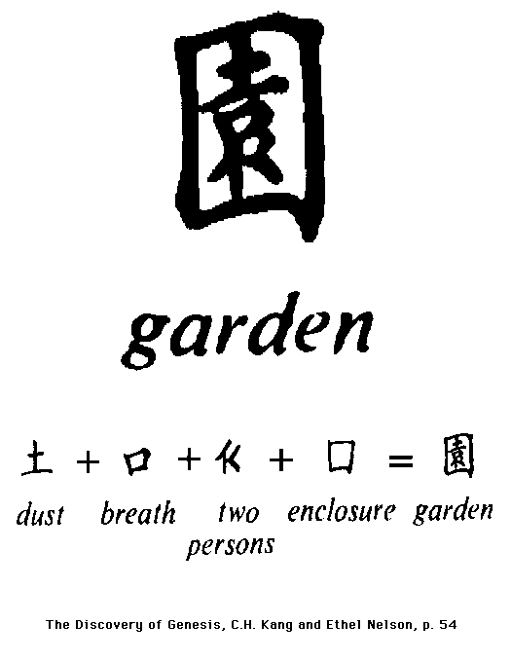

Slide 7
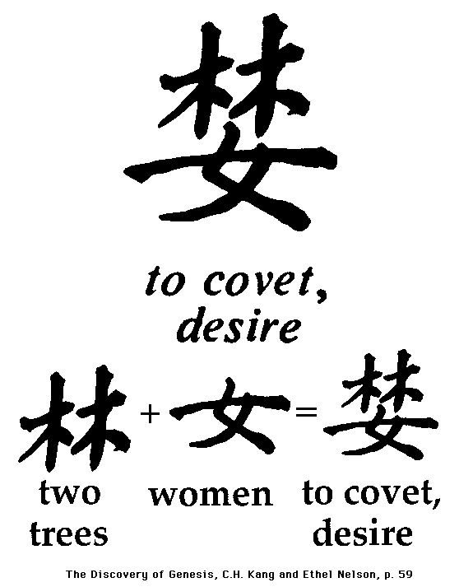
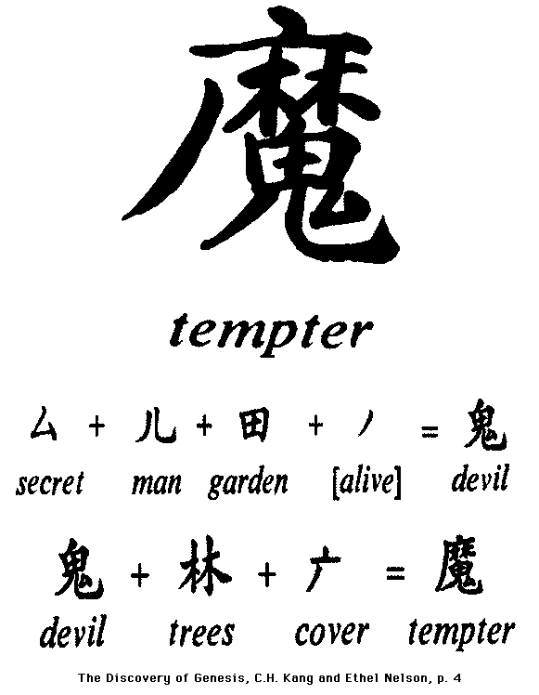
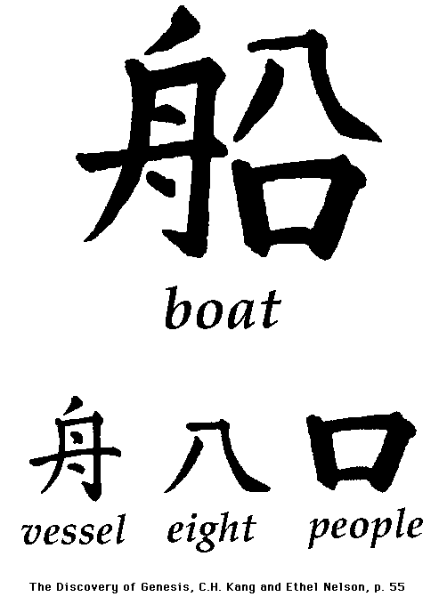

Slide 9
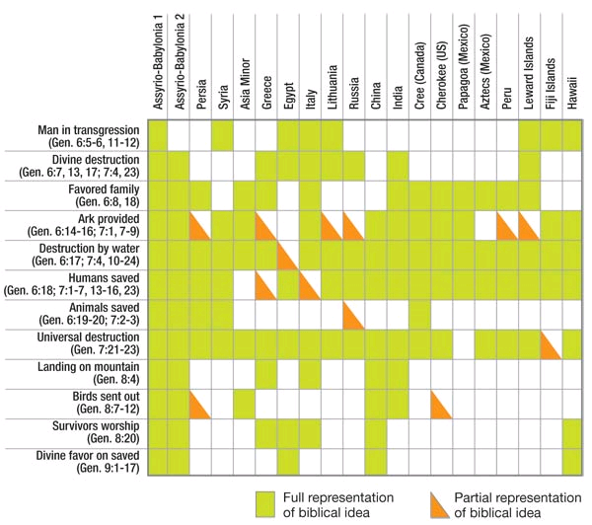

Slide 10
Christianity is NOT merely a western religion!!!

Slide 11
Conclusion
As Emperor Shun prayed to Shang-Ti in 2230 B.C., “As engraven on the heart of Thy poor servant is the sense of Thy goodness, so that my feeling cannot be fully displayed. With great kindness Thou dost bear with us, and not withstanding our demerits, dost grant us life and prosperity.”
Humble yourself before this heavenly ruler – the supreme ruler of all the earth!!!

